Slide 1
ECE 753: FAULT-TOLERANT COMPUTING
Kewal K.Saluja
Department of Electrical and Computer Engineering
Basic Concepts in Fault-Tolerance

Slide 2
Overview
Introduction - Sources
Hardware redundancy
Information redundancy
Time redundancy
Software redundancy
ECE 753 Fault Tolerant Computing
Notes:
Do not discuss much about topics here.
Under computer system
overall implies what is a compute system - its architecture and
components
Then focus on hardware and software components

Slide 3
Introduction
Sources
  Main source – Text Chapters 2 and 3
  Other sources
    [prad:96] Chapter 1
    [siew:99] Chapter 3
    [Shooman:02] Chapter 4
  These three books contain sufficient material covering this part of the course.
ECE 753 Fault Tolerant Computing
Notes:
Be sure everyone has a conduct sheet.
Re GROUND RULES:
1. In terms of allowed collaboration vs. individual work, ask if you are not sure.
2. Deactivate all cell phones or pagers during class unless you are on-call during your job.
3. No tape-recording permitted. Take notes.

Slide 4
Introduction (contd.)
Scope - Explain using the example of a filter
  inputs
  A/D
  digital subsystem - DSP/custom design
  D/A
  outputs
Problems and solutions
  inputs out of range
    add extra code to check out of range inputs and outputs
    can also add code to check large deviations between samples
    software redundancy normally - could do in hardware but costly
ECE 753 Fault Tolerant Computing
Notes:
Be sure everyone has a conduct sheet.
Re GROUND RULES:
1. In terms of allowed collaboration vs. individual work, ask if you are not sure.
2. Deactivate all cell phones or pagers during class unless you are on-call during your job.
3. No tape-recording permitted. Take notes.

Slide 5
Introduction (contd.)
Problems and solutions - contd.
  Power transients may corrupt the values or fault algorithm
    read values twice, execute algorithm twice and compare results in hardware or software
    Time redundancy
  Values transmitted by A/D to the digital system may get corrupted
    encode the values and decode them at the destination
    Information redundancy
  Components (DSP processor or A/D or D/A) may fail
    duplicate such parts
    Hardware redundancy
ECE 753 Fault Tolerant Computing
Notes:
Be sure everyone has a conduct sheet.
Re GROUND RULES:
1. In terms of allowed collaboration vs. individual work, ask if you are not sure.
2. Deactivate all cell phones or pagers during class unless you are on-call during your job.
3. No tape-recording permitted. Take notes.

Slide 6
Hardware redundancy
Passive hardware redundancy
  TMR with a voter
    main problem
      single point of failure
    justification - voter is much lower complexity and can be designed using more reliable technology
    alternative - use of restoring organ
      TMR with triplicated voter
  NMR voter based generalization
  Hardware voter (1-bit), software voter - simple
  Timing issue - sandwich between pairs of FFs
ECE 753 Fault Tolerant Computing
Notes:
Be sure everyone has a conduct sheet.
Re GROUND RULES:
1. In terms of allowed collaboration vs. individual work, ask if you are not sure.
2. Deactivate all cell phones or pagers during class unless you are on-call during your job.
3. No tape-recording permitted. Take notes.

Slide 7
Hardware redundancy (contd.)
Passive hardware redundancy (contd.)
  Comparison between hw and sw voter schemes
        hw sw
  cost high low
  flexibilty inflex flex
  synch tightly loosely
  perfor high low
        (fast) (slow)
  types of majority diff
  voting* (others costly) (no extra cost)
ECE 753 Fault Tolerant Computing
Notes:
Be sure everyone has a conduct sheet.
Re GROUND RULES:
1. In terms of allowed collaboration vs. individual work, ask if you are not sure.
2. Deactivate all cell phones or pagers during class unless you are on-call during your job.
3. No tape-recording permitted. Take notes.

Slide 8
Hardware redundancy (contd.)
Passive hardware redundancy (contd.)
  types of voting
    majority
      in many practical situations it is meaningless
    average
      can have poor performance if a sensor always provide very low value
    mid value
      a good choice - can be very costly to implement in HW
ECE 753 Fault Tolerant Computing
Notes:
Be sure everyone has a conduct sheet.
Re GROUND RULES:
1. In terms of allowed collaboration vs. individual work, ask if you are not sure.
2. Deactivate all cell phones or pagers during class unless you are on-call during your job.
3. No tape-recording permitted. Take notes.

Slide 9
Hardware redundancy (contd.)
Active hardware redundancy
  Key - detect fault, locate, reconfigure
    See figure 1.6 of [prad:96]
  duplicate with comparison
    single point of failure
  standby sparing
    one operational unit - it has its own fault detection mechanism
    on occurrence of fault a second unit (spare) is used
      cold standby - standby is in unknown state
      hot standby - standby is same state as system - quick start
    can generalize to n - one active and n-1 standby spares
ECE 753 Fault Tolerant Computing
Notes:
Be sure everyone has a conduct sheet.
Re GROUND RULES:
1. In terms of allowed collaboration vs. individual work, ask if you are not sure.
2. Deactivate all cell phones or pagers during class unless you are on-call during your job.
3. No tape-recording permitted. Take notes.

Slide 10
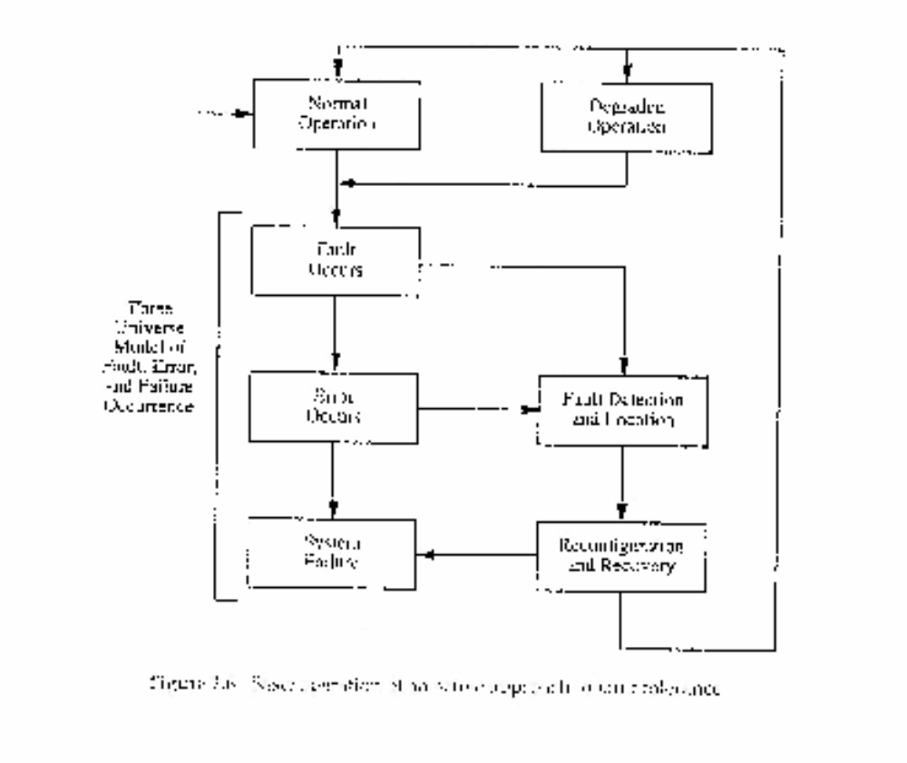
Active approach to FT
Basic operations in active fault tolerance - Source: Pradhand 1996
ECE 753 Fault Tolerant Computing

Slide 11
Hardware redundancy (contd.)
Active hardware redundancy (contd.)
  Pair-and-a-spare - this combines “duplicate with comparison” with “standby sparing”
    duplicate units (pair of units) are used to compare and signal an error to the reconfiguration unit
    second duplicate (pair, and possibly more in case of pair and k-spare) is used to take over in case the working duplicate (pair) detects an error
    a pair is always operational
  Watchdog timer
    a “timer” - substantially low cost hardware monitors the function of the working unit
ECE 753 Fault Tolerant Computing
Notes:
Be sure everyone has a conduct sheet.
Re GROUND RULES:
1. In terms of allowed collaboration vs. individual work, ask if you are not sure.
2. Deactivate all cell phones or pagers during class unless you are on-call during your job.
3. No tape-recording permitted. Take notes.

Slide 12
Hardware redundancy (contd.)
Hybrid hardware redundancy
  Key - combine passive and active redundancy schemes
  NMR with spares
    example - 5 units
      3 in TMR mode
      2 spares
      all 5 connected to a switch that can be reconfigured
    comparison with 5MR
      5MR can tolerate only two faults where as hybrid scheme can tolerate three faults that occur sequentially
      cost of the extra fault-tolerance: switch
ECE 753 Fault Tolerant Computing
Notes:
Be sure everyone has a conduct sheet.
Re GROUND RULES:
1. In terms of allowed collaboration vs. individual work, ask if you are not sure.
2. Deactivate all cell phones or pagers during class unless you are on-call during your job.
3. No tape-recording permitted. Take notes.

Slide 13
Hardware redundancy (contd.)
Hybrid hardware redundancy (contd.)
  Self purging redundancy
    initially start with NMR
    purge one unit at at time till arrive at 3MR
      can tolerate more faults initially compared to NMR with spare
      cost of the switch - higher?
      How does it compare to sift-out redundancy?
  Triple-duplex redundancy
    combines duplication-with-compare and TMR
ECE 753 Fault Tolerant Computing
Notes:
Be sure everyone has a conduct sheet.
Re GROUND RULES:
1. In terms of allowed collaboration vs. individual work, ask if you are not sure.
2. Deactivate all cell phones or pagers during class unless you are on-call during your job.
3. No tape-recording permitted. Take notes.

Slide 14
Information redundancy
Key concept - add redundancy to information/data
  all schemes use Error detecting or Error correcting coding
Use of parity
  very effective single error detection
  encoding and decoding cost is low
  commonly used in memories, transmission over short reliable channels
  limitations
    unable to detect common multiple errors
    can not be used in data transformation - for example addition does not preserve parity
ECE 753 Fault Tolerant Computing
Notes:
Be sure everyone has a conduct sheet.
Re GROUND RULES:
1. In terms of allowed collaboration vs. individual work, ask if you are not sure.
2. Deactivate all cell phones or pagers during class unless you are on-call during your job.
3. No tape-recording permitted. Take notes.

Slide 15
Information redundancy (Contd.)
Error correcting codes
  triplication
  Hamming code - you have learnt it
  byte error detection/correction - to be discussed later
  cyclic code - see book
m-out-of-n codes
  encode each word (data/control) such that the coded word is of length n and each coded word has exactly m 1’s in it
    can detect all single errors
    can detect all unidirectional multiple errors
ECE 753 Fault Tolerant Computing
Notes:
Be sure everyone has a conduct sheet.
Re GROUND RULES:
1. In terms of allowed collaboration vs. individual work, ask if you are not sure.
2. Deactivate all cell phones or pagers during class unless you are on-call during your job.
3. No tape-recording permitted. Take notes.

Slide 16
Information redundancy (Contd.)
Berger codes
  n information bits are encoded into an n+k bit code word. The k check bits are binary encoding of the number of 1’s (or 0’s) in the n information bits
    can detect all single errors
    can detect all unidirectional multiple errors if carefully designed
Arithmetic codes
  AN code
    used for arithmetic function unit designs
    each data word is multiplied by a constant A
    makes use of the identity A(N+M) = AN + AM
    choice of A is important
ECE 753 Fault Tolerant Computing
Notes:
Be sure everyone has a conduct sheet.
Re GROUND RULES:
1. In terms of allowed collaboration vs. individual work, ask if you are not sure.
2. Deactivate all cell phones or pagers during class unless you are on-call during your job.
3. No tape-recording permitted. Take notes.

Slide 17
Information redundancy (Contd.)
Arithmetic codes (Contd.)
  Residue code
    discussed earlier in the course using modulo addition
    makes use of the fact
    (M+N) mod k = (M mod k + N mod k) mod k
  Checksums
    data is sent/stored with a checksum and when used the checksum is regenerated and compared to the a priory known checksum
    functions used for checksum
      add, exclusive-OR (bit wise), end with end around carry, LFSR, …
    limitation
      can only perform (normally) error detection
ECE 753 Fault Tolerant Computing
Notes:
Be sure everyone has a conduct sheet.
Re GROUND RULES:
1. In terms of allowed collaboration vs. individual work, ask if you are not sure.
2. Deactivate all cell phones or pagers during class unless you are on-call during your job.
3. No tape-recording permitted. Take notes.

Slide 18
Information redundancy (Contd.)
Self-Checking
  This is a form of hardware redundancy but often it is closely related to ECC techniques, therefore I have chosen to include it here
  Assumptions: inputs are coded and outputs are coded
  Objective: in the presence of a fault the circuit should either continue to provide correct output(s) or indicate by providing an error indication that there is a fault.
    Clearly error indication can not be 1-bit output (why?)
    With 2-bits output, 00 and 11 may indicate no failure
    other output combinations (10, 01) may indicate a failure
ECE 753 Fault Tolerant Computing
Notes:
Be sure everyone has a conduct sheet.
Re GROUND RULES:
1. In terms of allowed collaboration vs. individual work, ask if you are not sure.
2. Deactivate all cell phones or pagers during class unless you are on-call during your job.
3. No tape-recording permitted. Take notes.

Slide 19
Information redundancy (Contd.)
Self-Checking (contd.)
  Example application
    two devices produce identical outputs and we compare these outputs to check their equality
    checker has two outputs encoded as follows
      00 equal
      11 unequal
      01 or 10 possible fault in the circuit
      (we will discuss input encoding when we discuss an example of a 2-rail 1-bit checker)
ECE 753 Fault Tolerant Computing
Notes:
Be sure everyone has a conduct sheet.
Re GROUND RULES:
1. In terms of allowed collaboration vs. individual work, ask if you are not sure.
2. Deactivate all cell phones or pagers during class unless you are on-call during your job.
3. No tape-recording permitted. Take notes.

Slide 20
Information redundancy (Contd.)
Self-Checking (contd.)
  Definitions
    a circuit is fault secure if in the presence of a fault, the output is either always correct, or not a code word for valid input code words
    a circuit is self-testing if only valid inputs can be used to test it for the faults
    a circuit is totally self-checking if it is fault secure and self-testing
  Example: a totally self-checking 2-rail 1-bit comparator
    assumptions
      2 inputs and each input x is available as x and its complement
      x and its complement are independently generated
      note with these assumption the input space is encoded (4 valid inputs out of 16 possible inputs)
      single stuck-at fault model
ECE 753 Fault Tolerant Computing
Notes:
Be sure everyone has a conduct sheet.
Re GROUND RULES:
1. In terms of allowed collaboration vs. individual work, ask if you are not sure.
2. Deactivate all cell phones or pagers during class unless you are on-call during your job.
3. No tape-recording permitted. Take notes.

Slide 21
Time redundancy
Key Concept - do a job more than once over time
  examples
    re-execution
    re-transmission of information
  different faults and capabilities of different schemes
    transient faults
      re-execution and re-transmission can detect such faults provided we wait for transient to subside
    permanent faults
      simple re-execution or re-transmission will not work. Possible solutions
        send or process shifted version of data
        send or process complemented data during second transmission
ECE 753 Fault Tolerant Computing
Notes:
Be sure everyone has a conduct sheet.
Re GROUND RULES:
1. In terms of allowed collaboration vs. individual work, ask if you are not sure.
2. Deactivate all cell phones or pagers during class unless you are on-call during your job.
3. No tape-recording permitted. Take notes.

Slide 22
Time redundancy (contd.)
  Different faults and capabilities of different schemes (contd.)
    faults in ALU
      re-execution with complement or shifted version can detects permanent and transient faults
      (RESO concept - re-computation with shifted operands)
    multiple re-computations
      can detect and possibly correct transient and permanent faults if properly employed/designed
ECE 753 Fault Tolerant Computing
Notes:
Be sure everyone has a conduct sheet.
Re GROUND RULES:
1. In terms of allowed collaboration vs. individual work, ask if you are not sure.
2. Deactivate all cell phones or pagers during class unless you are on-call during your job.
3. No tape-recording permitted. Take notes.

Slide 23
Software redundancy
Key concept - many copies of software including replication, alternative programs, and redundant code
Different schemes
  consistency/assertions checks and tests
    results are too large?
    are the values indeed sorted?
    is hardware working correctly? - periodic testing
    model checking - build a model of the system and check the outputs of the system against the model output - application in process control systems
ECE 753 Fault Tolerant Computing
Notes:
Be sure everyone has a conduct sheet.
Re GROUND RULES:
1. In terms of allowed collaboration vs. individual work, ask if you are not sure.
2. Deactivate all cell phones or pagers during class unless you are on-call during your job.
3. No tape-recording permitted. Take notes.

Slide 24
Software redundancy (contd.)
Different schemes
  Capability checks
    check system limits and capabilities
    examples
      is a write in an address space beyond the memory boundary?
        can write and read back to see if the information is there
      in multiprocessor environment, communicate and establish if a processor is alive before shipping computation/code
ECE 753 Fault Tolerant Computing
Notes:
Be sure everyone has a conduct sheet.
Re GROUND RULES:
1. In terms of allowed collaboration vs. individual work, ask if you are not sure.
2. Deactivate all cell phones or pagers during class unless you are on-call during your job.
3. No tape-recording permitted. Take notes.

Slide 25
Software redundancy (contd.)
Different schemes
  N-version programming (software equivalent of NMR)
    N programs produce N values and a voter (normally software but can also be a hardware voter) votes on N values
    What does it achieve
      can tolerate software faults (what ever these may be - such as bit-flips) but will not tolerate design flaws
      if software runs on independent hardware components, it will tolerate hardware faults
      if same hardware then it will tolerate transient faults that may affect the hardware
      if different software components are different versions or different algorithm implementations, then this method will tolerate both software and hardware faults
ECE 753 Fault Tolerant Computing
Notes:
Be sure everyone has a conduct sheet.
Re GROUND RULES:
1. In terms of allowed collaboration vs. individual work, ask if you are not sure.
2. Deactivate all cell phones or pagers during class unless you are on-call during your job.
3. No tape-recording permitted. Take notes.

Slide 26
Software redundancy (contd.)
Different schemes
  Recovery block (software equivalent of standby sparing - normally more like cold standby version but active hardware redundancy)
    different program versions, normally different algorithms implemented by the same or different programmers are used
    fastest, best, or primary version is normally in use
    if it fails an “acceptance test” next version is invoked
    Notes
      graceful degradation is possible
      used where acceptance tests can be specified
ECE 753 Fault Tolerant Computing
Notes:
Be sure everyone has a conduct sheet.
Re GROUND RULES:
1. In terms of allowed collaboration vs. individual work, ask if you are not sure.
2. Deactivate all cell phones or pagers during class unless you are on-call during your job.
3. No tape-recording permitted. Take notes.

Slide 27
Software redundancy (contd.)
Different schemes
  N-self checking (software equivalent of pair and spare with hot standby)
    different program versions, with each its acceptance test
    more than one version in use
    outputs are configured through a switch (conditional statement)
    if one pair fails, the result from the second version is used as soon as available
ECE 753 Fault Tolerant Computing
Notes:
Be sure everyone has a conduct sheet.
Re GROUND RULES:
1. In terms of allowed collaboration vs. individual work, ask if you are not sure.
2. Deactivate all cell phones or pagers during class unless you are on-call during your job.
3. No tape-recording permitted. Take notes.

Slide 28
Summary
An example to define the scope and list methods
Hardware redundancy
  passive, active, and hybrid
Information redundancy
  coding method and self-checking
Time redundancy
  re-execution, re-transmission, and RESO concept
Software redundancy
  consistency checks, assertion check, N-version programming, capability checks, recovery block, and N-self checking
ECE 753 Fault Tolerant Computing
Notes:
Be sure everyone has a conduct sheet.
Re GROUND RULES:
1. In terms of allowed collaboration vs. individual work, ask if you are not sure.
2. Deactivate all cell phones or pagers during class unless you are on-call during your job.
3. No tape-recording permitted. Take notes.

Slide 29
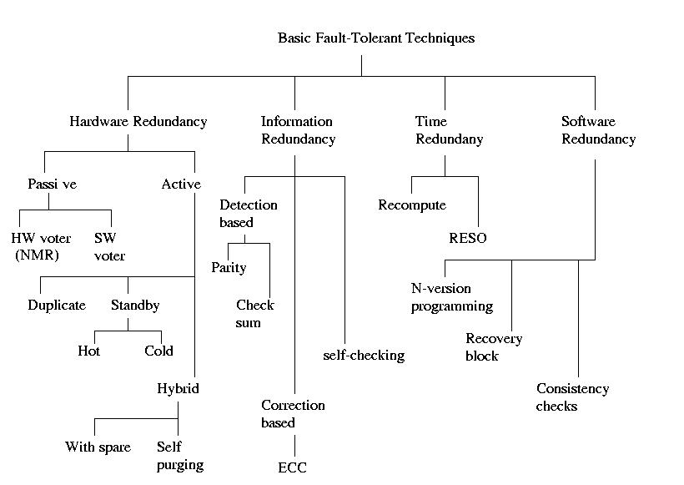
Summary (contd.)
A summary chart of all techniques
ECE 753 Fault Tolerant Computing
Notes:
Be sure everyone has a conduct sheet.
Re GROUND RULES:
1. In terms of allowed collaboration vs. individual work, ask if you are not sure.
2. Deactivate all cell phones or pagers during class unless you are on-call during your job.
3. No tape-recording permitted. Take notes.

